Slide 1
ENGL 4900: CAPSTONE
Librarian: Abbie Holmes, MLIS, MA

Slide 2
HAVE QUESTIONS? CONTACT ME:
Abbie Holmes, MLIS, MA
Phone: (478) 471-2093
Email: abbie.holmes@mga.edu
Office 137
Macon Campus Library:
Phone: (478) 471-2093
Text a librarian: (478) 285-4898
Chat with a librarian via www.mga.edu/library

Slide 3
THE BASICS: WHAT TYPES OF SOURCES ARE WE LOOKING FOR?

Slide 4
SOURCES: WHAT TYPES ARE AVAILABLE
Primary Sources
Original Source, not filtered through a process of analysis or interpretation
Secondary Sources
Academic Journal Article
Example: Novel or Poem
Example: Essay about themes in the work

Slide 5
SEARCH TECHNIQUES
BOOLEAN OPERATORS
TRUNCATION
CONTROLLED VOCABULARY
SEARCH QUOTES
CITATION TRACKING

Slide 6
BOOLEAN OPERATORS
What are they?
Terms that tell the database how to connect words and conduct your search
AND: Connects several terms to get fewer results
OR: Connects several terms to get more results (either or)
NOT: Eliminates a term in the results lists

Slide 7
TRUNCATION
A technique that broadens your search to include various word endings. By adding truncation to your search string, the database will return results that include any ending of your root word.
To use:
Enter the root of a word and put the truncation symbol (*) at the end
Example:
theor* = theory, theoretical, theorem, etc.

Slide 8
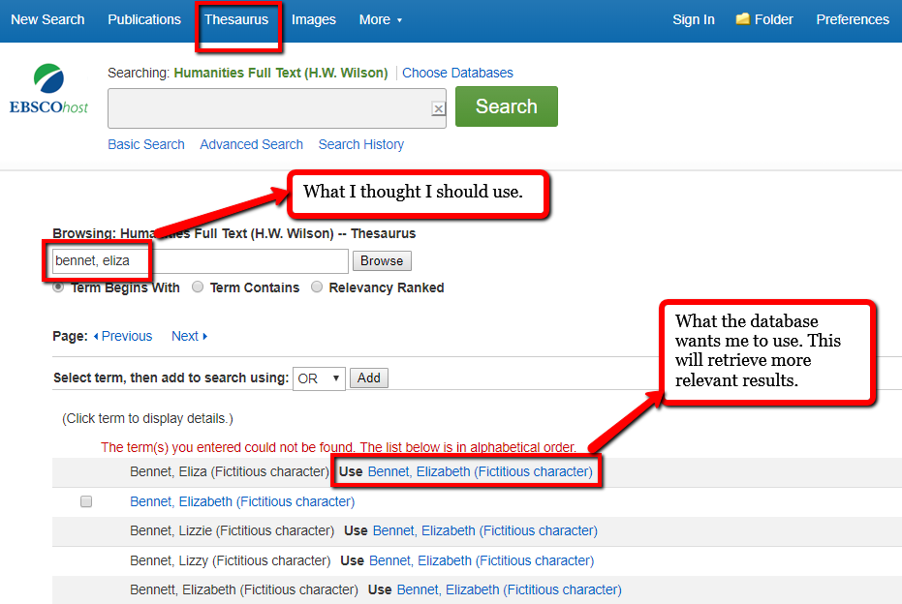
CONTROLLED VOCABULARY
•A set of terms that databases use to describe and label their information/sources
•Allows for greater precision in searching
•Use the Subject Terms (a thesaurus) tab to find what subject term this particular database uses

Slide 9
SEARCH QUOTES
A technique that narrows your search to include only the words within quotation marks and in the order given.
To use:
Place quotation marks around phrases, concepts, and names with two or more words.
Examples:
“Elizabeth Bennet” or “Charlotte Lucas”
“The Gold Bug”
“Little Dorrit”

Slide 10
CITATION TRACKING
What sort of information do you need to track a journal citation?
The name of the journal
The author of the article
The publication date
Volume and issue numbers
Page numbers

Slide 11
STEPS FOR TRACKING DOWN YOUR ARTICLE
On the Library home page, click “Find A Journal.”
Type in the name of the journal.
“Search within publication.” Start by typing the article title in the search bar.
You can also choose “Full Text Access.” Find the database that has the publication date that you need.

Slide 12
LET’S FIND THESE ARTICLES
Davis, M. (2004). Gothic's enigmatic signifier: The case of J. sheridan le fanu's 'carmilla'. Gothic Studies, 6(2), 223-V.
Leayell, Lori. “Poe’s Steadfast Servant in the Aftermath of Walker’s Appeal.” Mississippi Quarterly, vol. 66, no. 4, Fall 2013, pp. 539–563.
Rockas, Leo. “Sisters Askew: ‘The Three Sisters’ and Pride and Prejudice.” Persuasions: The Jane Austen Journal Online, vol. 33, no. 1, Winter 2012.
Self, Kathleen M. “The Valkyrie’s Gender: Old Norse Shield-Maidens and Valkyries as a Third Gender.” Feminist Formations, vol. 26, no. 1, Spring 2014, p. 143.

Slide 13
YOU’VE FOUND ARTICLES… NOW WHAT SHOULD YOU DO WITH THEM?

Slide 14
Example:
You are Writing about: Charlotte Bronte’s novel Jane Eyre
Kind of Source | Explanation | Example from Literature
B= Background Sources | Any source used in a paper to provide context or background | Encyclopedia article on evangelism Biography of Bronte Books or articles on the history/ culture of a literary period example: Victorian Life and Times
E=Evidence or Exhibit sources | Observations, data, documents or other particulars used to support your argument | Quotations, paraphrases, or text citations from Jane Eyre
A= Argument sources | The conversation of critical views and relevant scholarship: Example: Other scholarly articles or papers | Books or scholarly articles that have addressed the writer’s critical problem in Jane Eyre Your goal is to add something new or challenging to the conversation
M= Method or Theory sources | References to theories or methods that the writer is employing | References to a specific critic References to a specific theory or method (feminism, post-colonialism, new historicism etc.)

Slide 15
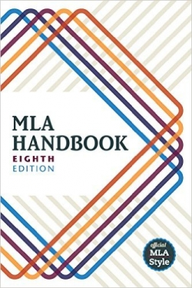
DOCUMENTING YOUR SOURCES
Mendeley: (https://www.mendeley.com/) a free reference manager, has a Microsoft Word extension.
Zotero: (https://www.zotero.org/)a free research tool to help you collect, organize and cite your sources has a Microsoft Word extension

Slide 16
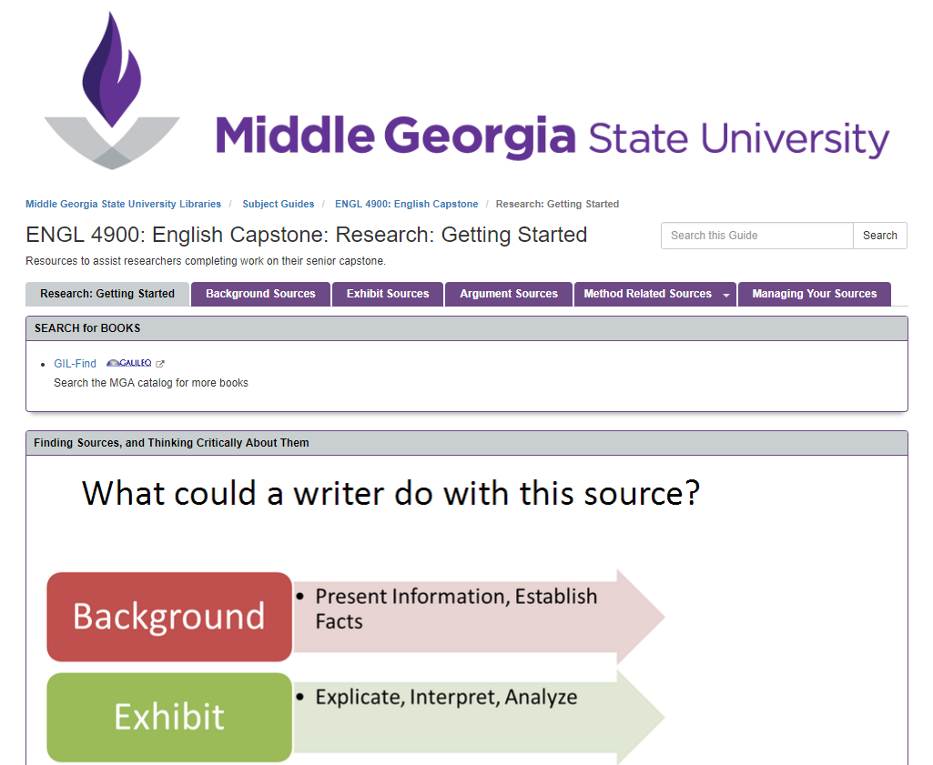
WHERE TO START:
ENGL 4900 Subject Guide
Information on accessing materials, the “BEAM” Method, and managing your sources.

Slide 17
FINDING BOOKS AND ARTICLES
For books: Search the Gil Find Catalog. Search for your author’s name by subject, and then narrow by clicking on one of the “suggested topics.”
For article sources: Look at the Subject Guide for Literature, then click on the tab to “Find Articles.” You can also search by subject “literature” in GALILEO, which will only return items from literature databases.

